Slide 1

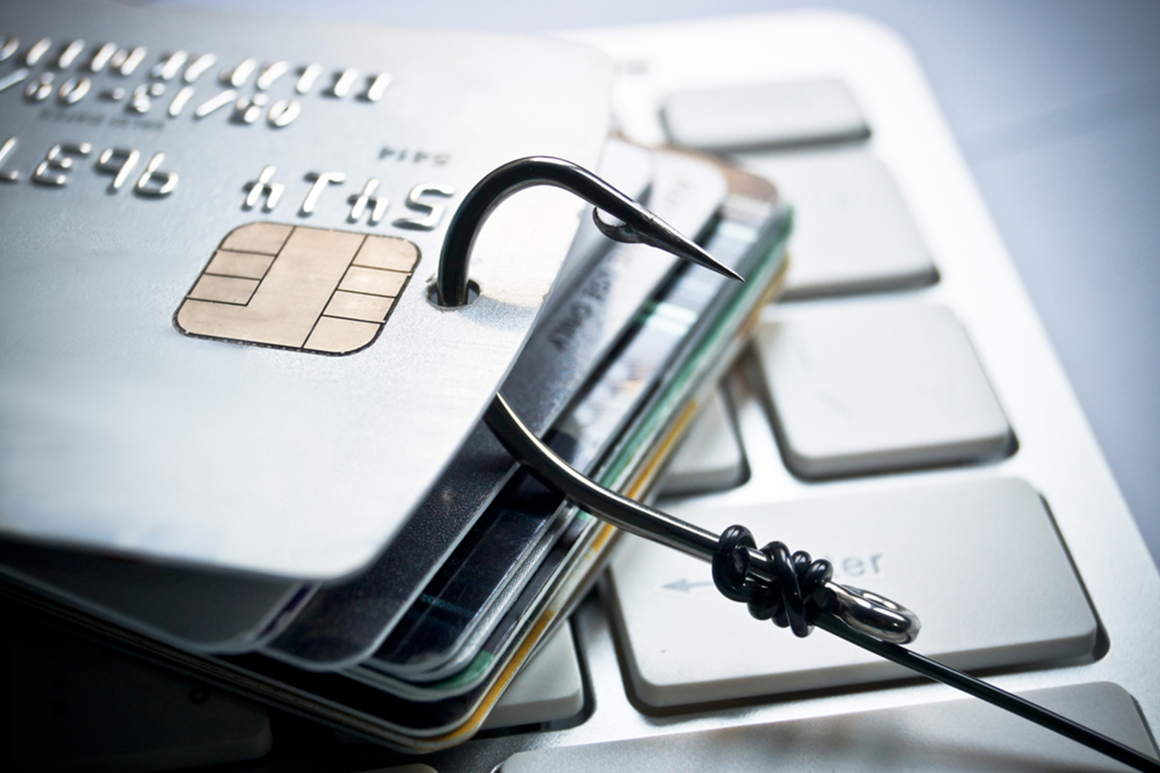
Credit Card Fraud Detection
A capstone presentation
Mark Anthony Duero

Slide 2


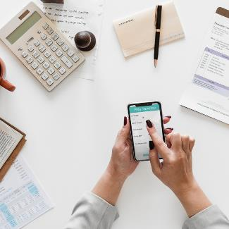
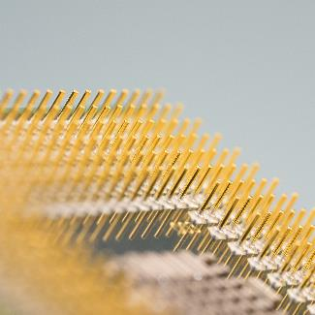

The Problem
Credit Card Fraud
Client Frustration
Chargeback
Slow process
Lost trust

Slide 3
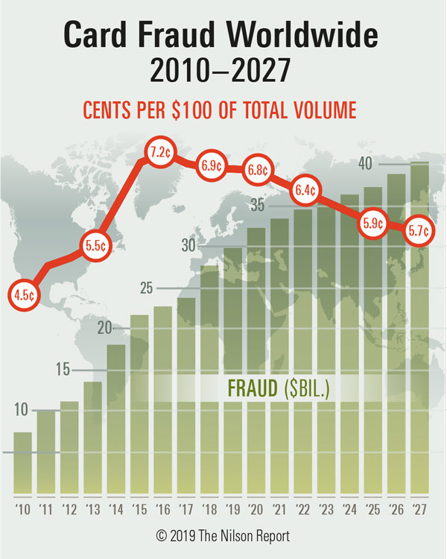
Annual Fraud Statistics
Gross fraud losses reached $27.85 billion in 2018, up 16.2% from $23.97 billion in 2017. However, fraud losses per $100 of total sales declined to 6.86¢ from 6.95¢ the prior year.

Slide 4
Common Types Of Credit Card Fraud
Application Fraud
CNP (Card Not Present) Fraud
Fake Cards
It happens when other people apply for credit or a new credit card in your name.
If somebody knows the expiry date and account number of your card, they can commit CNP fraud against you.
The card isn’t linked to an account, so the credit card company will not pay for the transaction since they cannot trace it to a specific user.

Slide 5

Solution
Credit Card Fraud Detection with Machine Learning is a process of data investigation by a Data Science team and the development of a model that will provide the best results in revealing and preventing fraudulent transactions. This is achieved through bringing together all meaningful features of card users’ transactions, such as Date, User Zone, Product Category, Amount, Provider, Client’s Behavioral Patterns, etc. The information is then run through a subtly trained model that finds patterns and rules so that it can classify whether a transaction is fraudulent or legitimate.
Credit card fraud detection with Machine Learning

Slide 6


ML Credit Card Fraud Detection vs Conventional Fraud Detection
Machine Learning-based Fraud Detection:
Conventional Fraud Detection:
Detecting fraud automatically
Real-time streaming
Less time needed for verification methods
Identifying hidden correlations in data
The rules of deciding on determining schemes should be set manually.
Takes an enormous amount of time
Multiple verification methods are needed; thus, inconvenient for the user
Finds only obvious fraud activity

Slide 7
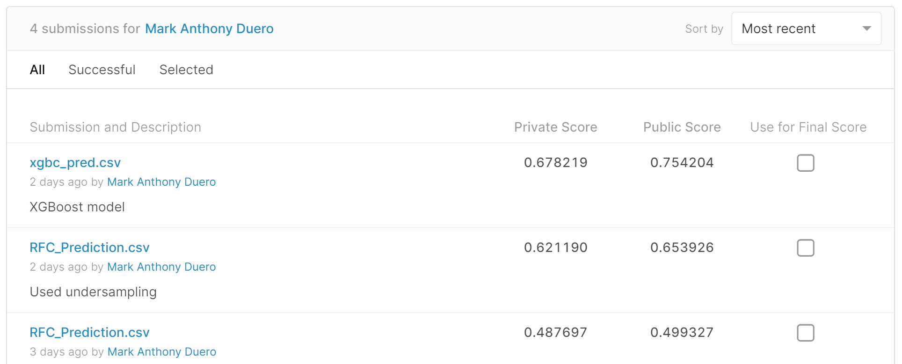
The model

Slide 8
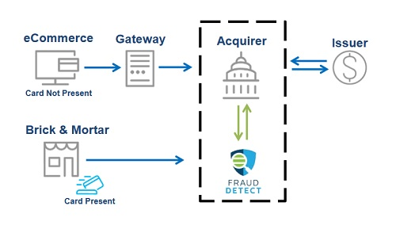
How Credit Card Fraud Detection Works

Slide 9
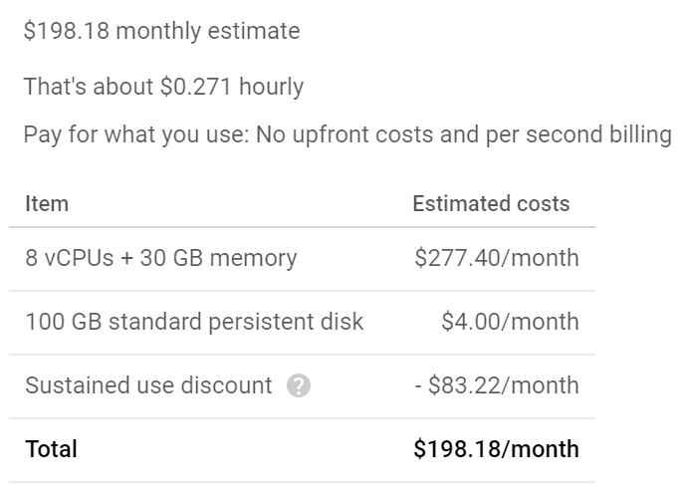
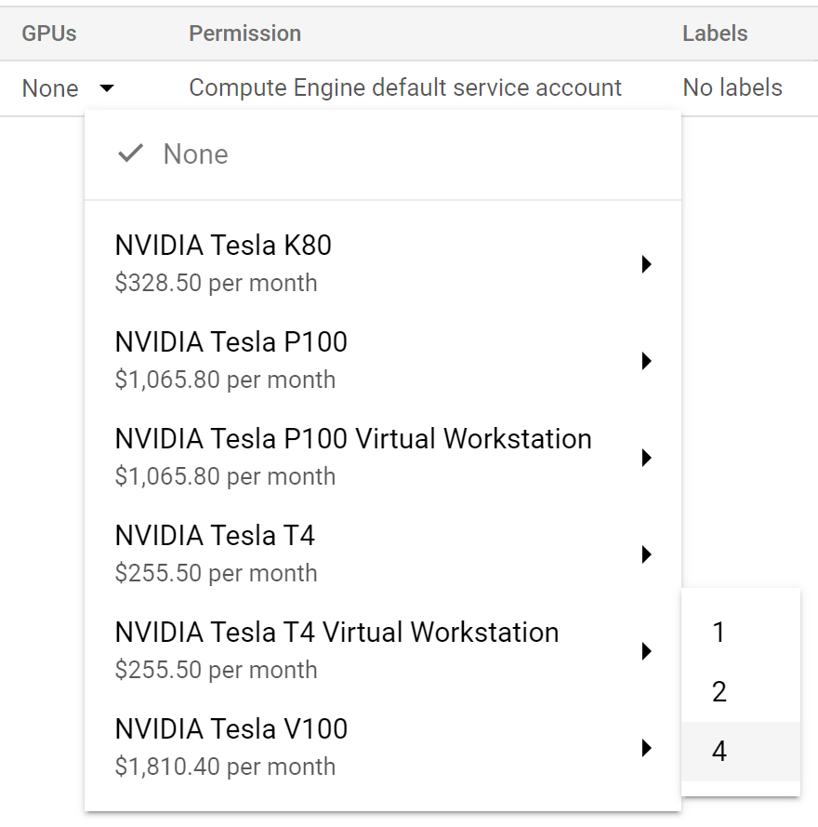
Implementation cost

Slide 10





Thank You
A Capstone presentation
Mark Anthony Duero
0423781887
andreibenj@gmail.com
https://profiles.generalassemb.ly/profiles/mark-anthony-duero

